Slide 1

PRESENTED TO: PRESENTED BY:
Dr. Anirudha Gaikwad Priyanshu Srivastava Assistant Professor RA2311003040035 Department of CSE Branch: CSE I

Slide 2

Market Basket Analysis: Uncovering Purchase Patterns
Market Basket Analysis (MBA) is a data mining technique used to identify strong associations or correlations between items that are frequently purchased together. The core idea is to find relationships between products, often in the context of a customer's shopping basket.
The primary purpose of MBA is to discover 'purchase patterns' or 'co-occurrence' of items. For instance, if a customer buys 'Bread' and 'Butter', what other item are they likely to purchase? This can be represented as an association rule: {Bread, Butter} → {Jam}, suggesting that customers who buy bread and butter often also buy jam.
This technique finds extensive applications in retail and e-commerce for shelf arrangement, cross-selling, promotional strategies, and inventory management. By understanding these patterns, businesses can make informed decisions to boost sales and enhance customer experience.

Slide 3
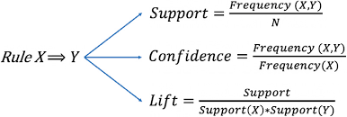
Association Rules & Key Measures
An association rule is an implication of the form X → Y, where X and Y are sets of items, and X and Y are disjoint. X is known as the antecedent and Y as the consequent. These rules reveal relationships like "customers who bought X also bought Y."
Support(X → Y)
P(X U Y)
To evaluate the strength and significance of these rules, three key measures are used:
Confidence(X → Y)
Support: Indicates how frequently the itemset X U Y appears in the dataset. A high support value suggests that the itemset is common.
Confidence: Measures how often items in Y appear in transactions that contain X. It quantifies the reliability of the rule.
Lift: Compares the observed frequency of X and Y appearing together with the frequency expected if X and Y were independent. A lift value greater than 1 suggests a positive correlation.
P(Y|X) = P(X U Y) / P(X)
Lift(X → Y)
P(Y|X) / P(Y)
The process typically starts with identifying 'frequent itemsets' (sets of items that appear together often) before generating the actual rules. Rule generation then involves creating rules from these frequent itemsets and filtering them based on minimum confidence thresholds.

Slide 4
The Apriori Algorithm
The Apriori algorithm is a classic method for mining frequent itemsets for Boolean association rules. Its core principle states that if an itemset is frequent, then all of its subsets must also be frequent. Conversely, if an itemset is infrequent, then all of its supersets must also be infrequent, enabling efficient pruning.
01
02
Candidate Generation
Pruning
In each iteration, Apriori generates candidate itemsets of length 'k' from the frequent itemsets of length 'k-1'.
It then prunes candidates by removing any itemset whose subset is not frequent. This significantly reduces the search space.
03
04
Support Counting
Rule Generation
The algorithm performs multiple passes over the database to count the support for remaining candidate itemsets, identifying truly frequent ones.
Once all frequent itemsets are found, association rules are generated and filtered based on minimum confidence thresholds.
While intuitive, Apriori's performance can degrade with very large datasets due to repeated database scans.

Slide 5




Limitations of the Apriori Algorithm
Despite its foundational importance, the Apriori algorithm faces several challenges, particularly when dealing with large and dense datasets.
Large Number of Candidates
High Time Complexity
Generating a vast number of candidate itemsets, especially for long patterns, can be computationally intensive and memory-consuming.
The process of generating and testing candidate itemsets often leads to a high time complexity, making it slow for massive datasets.
Multiple Database Scans
Inefficient for Big Data
Apriori requires scanning the entire database multiple times (once for each iteration of candidate generation), which is a significant bottleneck for large databases stored on disk.
The combination of these limitations makes Apriori less efficient and practical for modern big data applications where speed and scalability are crucial.
These drawbacks paved the way for the development of more efficient algorithms like FP-Growth.

Slide 6
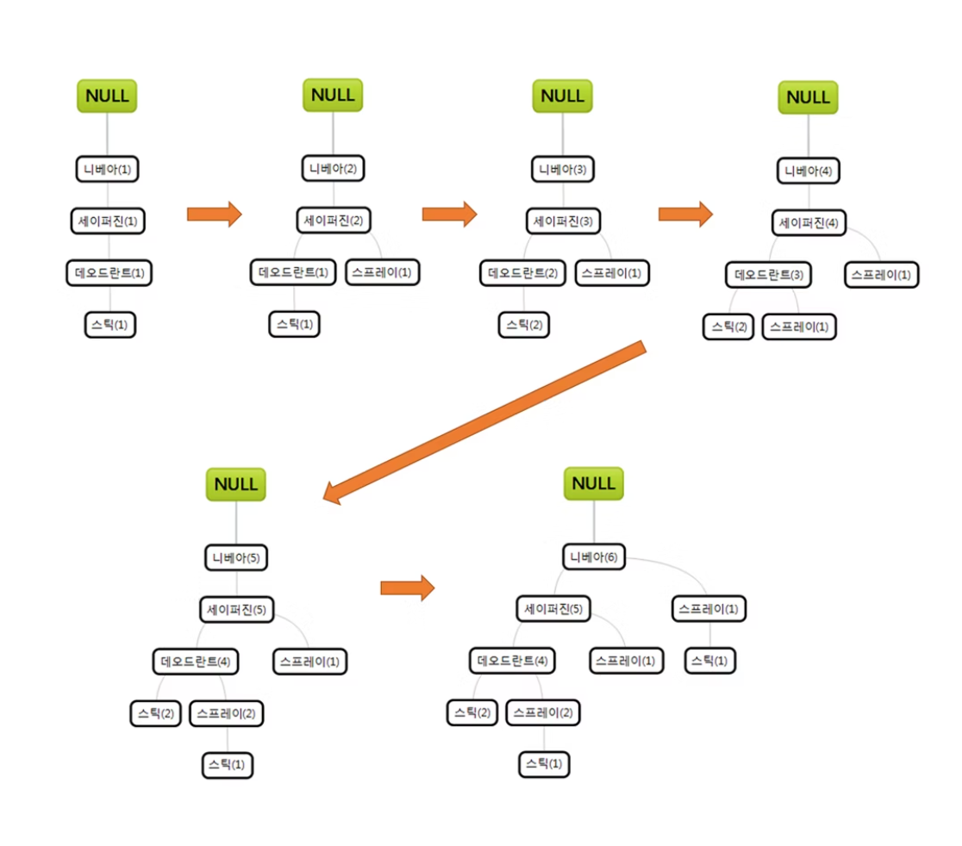
Mining Frequent Itemsets Without Candidate Generation (FP-Growth)
The need for more efficient algorithms to overcome Apriori's limitations led to the development of FP-Growth. This algorithm aims to avoid the costly candidate generation step by employing a "divide and conquer" strategy.
FP-Growth constructs a highly compact data structure called an FP-Tree (Frequent Pattern Tree). This tree stores all necessary information about frequent itemsets in a compact manner. Each node in the tree represents an item, and its count indicates how many transactions contain that item up to that point in the path.
The 'Pattern Growth' approach then extracts frequent itemsets directly from the FP-Tree without any candidate generation. It recursively mines conditional FP-Trees, efficiently discovering all frequent patterns.
The primary advantage of FP-Growth over Apriori is its efficiency, especially for dense datasets, as it avoids repeated database scans and the combinatorial explosion of candidate itemsets.

Slide 7

Mining Frequent Itemsets Using Vertical Data
Traditional association rule mining often uses a horizontal data format (transaction ID → list of items). However, vertical data mining offers an alternative, often more efficient, approach.
In a vertical data format, data is represented as Item → TID List, where a TID list contains the Transaction IDs in which the item appears. For example, Milk: {T100, T200, T300}.
The ECLAT algorithm (Equivalence Class Transformation) is a popular technique for mining frequent itemsets from vertical data. It uses intersection operations on TID lists to find support for itemsets.
To find the support of an itemset like {Milk, Bread}, ECLAT simply intersects the TID lists of 'Milk' and 'Bread'. The length of the resulting intersected list is the support count. This approach eliminates the need for generating candidate itemsets and scanning the database multiple times, similar to FP-Growth.
Benefits of vertical mining include faster support counting, especially for sparse datasets, and efficient storage, making it suitable for certain data structures and parallel processing.

Slide 8
Multidimensional Association Rules
Beyond simple item co-occurrence, association rules can involve multiple dimensions or attributes of the data, leading to multidimensional association rules.
These rules examine relationships between items across different dimensions, such as demographic attributes, product categories, or time. For example, a rule might be: (Age: 20-29, Income: High) → {Buys: Luxury Car}. This rule combines customer attributes (Age, Income) with a purchase behaviour.
Inter-Dimensional Rules
Hybrid-Dimensional Rules
Involve attributes from different dimensions, e.g., Age AND Occupation → ProductBought.
Combine both inter-dimensional and intra-dimensional predicates, e.g., Age AND Income AND ProductType → SpecificProduct.
These rules offer deeper insights into customer behaviour, enabling targeted marketing campaigns, personalised recommendations, and more sophisticated business strategies. They move beyond transactional data to incorporate rich contextual information, providing a holistic view of associations.

